Slide 1
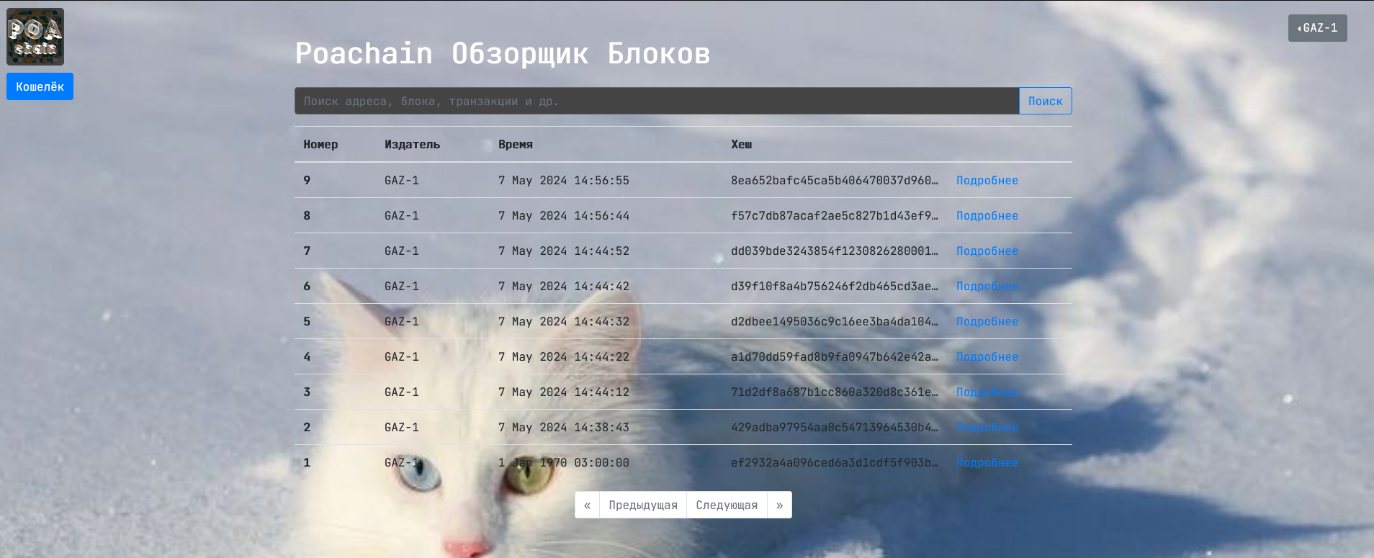
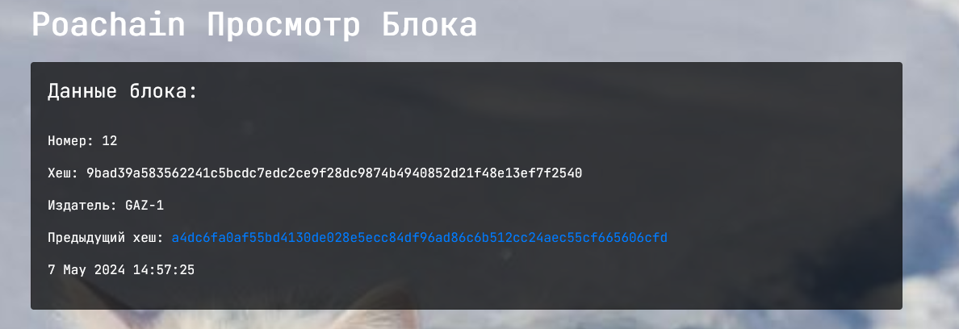
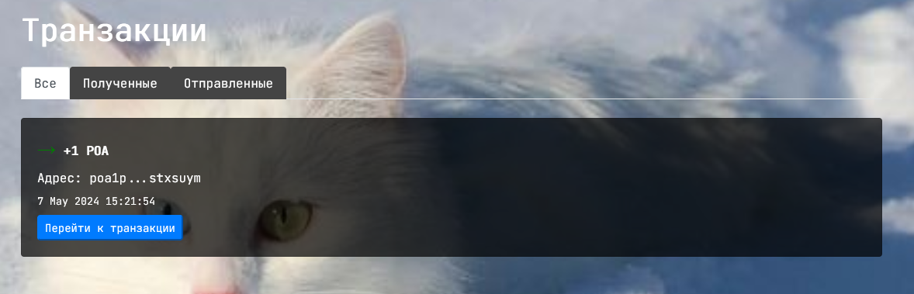
Федеральное государственное бюджетное образовательное учреждение высшего образования
«Нижегородский государственный архитектурно-строительный университет» (ННГАСУ)
ВЫПУСКНАЯ КВАЛИФИКАЦИОННАЯ РАБОТА
Разработка механизма прямых трансграничных финансовых операций между цифровыми валютами разных стран
Выполнил:
Студент группы ИС-29
Самедов Н.Ю.
Руководитель: -

Slide 2
from enum import Enum class Encoding(Enum): """Enumeration type to list the various supported encodings.""" BECH32 = 1 BECH32M = 2 CHARSET = "qpzry9x8gf2tvdw0s3jn54khce6mua7l" BECH32M_CONST = 0x2BC830A3 def bech32_polymod(values): """Internal function that computes the Bech32 checksum.""" generator = [0x3B6A57B2, 0x26508E6D, 0x1EA119FA, 0x3D4233DD, 0x2A1462B3] chk = 1 for value in values: top = chk >> 25 chk = (chk & 0x1FFFFFF) << 5 ^ value for i in range(5): chk ^= generator[i] if ((top >> i) & 1) else 0 return chk def bech32_hrp_expand(hrp): """Expand the HRP into values for checksum computation.""" return [ord(x) >> 5 for x in hrp] + [0] + [ord(x) & 31 for x in hrp] def bech32_verify_checksum(hrp, data): """Verify a checksum given HRP and converted data characters.""" const = bech32_polymod(bech32_hrp_expand(hrp) + data) if const == 1: return Encoding.BECH32 if const == BECH32M_CONST: return Encoding.BECH32M return None def bech32_create_checksum(hrp, data, spec): """Compute the checksum values given HRP and data.""" values = bech32_hrp_expand(hrp) + data const = BECH32M_CONST if spec == Encoding.BECH32M else 1 polymod = bech32_polymod(values + [0, 0, 0, 0, 0, 0]) ^ const return [(polymod >> 5 * (5 - i)) & 31 for i in range(6)] def bech32_encode(hrp, data, spec) -> str: """Compute a Bech32 string given HRP and data values.""" combined = data + bech32_create_checksum(hrp, data, spec) return hrp + "1" + "".join([CHARSET[d] for d in combined]) def bech32_decode(bech): """Validate a Bech32/Bech32m string, and determine HRP and data.""" if (any(ord(x) < 33 or ord(x) > 126 for x in bech)) or ( bech.lower() != bech and bech.upper() != bech ): return None, None, None bech = bech.lower() pos = bech.rfind("1") if pos < 1 or pos + 7 > len(bech) or len(bech) > 90: return None, None, None if not all(x in CHARSET for x in bech[pos + 1 :]): return None, None, None hrp = bech[:pos] data = [CHARSET.find(x) for x in bech[pos + 1 :]] spec = bech32_verify_checksum(hrp, data) if spec is None: return None, None, None return hrp, data[:-6], spec def convertbits(data, frombits, tobits, pad=True) -> list[int] | None: """General power-of-2 base conversion.""" acc = 0 bits = 0 ret = [] maxv = (1 << tobits) - 1 max_acc = (1 << (frombits + tobits - 1)) - 1 for value in data: if value < 0 or (value >> frombits): return None acc = ((acc << frombits) | value) & max_acc bits += frombits while bits >= tobits: bits -= tobits ret.append((acc >> bits) & maxv) if pad: if bits: ret.append((acc << (tobits - bits)) & maxv) elif bits >= frombits or ((acc << (tobits - bits)) & maxv): return None return ret def decode(hrp, addr): """Decode a segwit address.""" hrpgot, data, spec = bech32_decode(addr) if hrpgot != hrp: return None, None decoded = convertbits(data[1:], 5, 8, False) if decoded is None or len(decoded) < 2 or len(decoded) > 40: return None, None if data[0] > 16: return None, None if data[0] == 0 and len(decoded) != 20 and len(decoded) != 32: return None, None if ( data[0] == 0 and spec != Encoding.BECH32 or data[0] != 0 and spec != Encoding.BECH32M ): return None, None return data[0], decoded def encode(hrp, witver, witprog) -> str | None: """Encode a segwit address.""" spec = Encoding.BECH32 if witver == 0 else Encoding.BECH32M ret = bech32_encode(hrp, [witver] + convertbits(witprog, 8, 5), spec) if decode(hrp, ret) == (None, None): return None return ret
Содержание
Актуальность
Цель работы
Поставленные задачи
Выявленные проблемы
Необходимые уникальные решения
Выбор средств разработки
Устройство нод
Интерфейс пользователя
Перспективы развития
Выводы

Slide 3
Актуальность

Slide 4
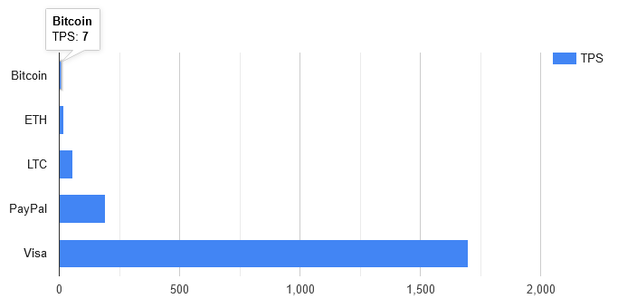
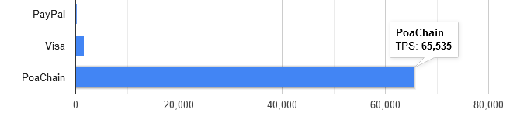
Проблема
Фиатная система не позволяет проводить трансграничные транзакции на фундаментальном уровне, а существующие блокчейны являются заложниками своих алгоритмов и консенсус-механизмов, из-за чего неудобны в использовании
Решение
Новый экономический слой (крипто)валюты, построенный на гибком и быстром консенус-механизме
Почему это актуально
Обход санкций, снижение издержек, прозрачность и безопасность, цифровизация экономики, поддержка экономики
Сравнение TPS (transaction per second) у разных финансовых систем

Slide 5
Цель работы

Slide 6
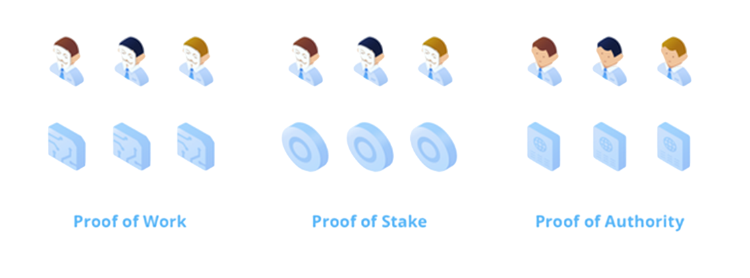
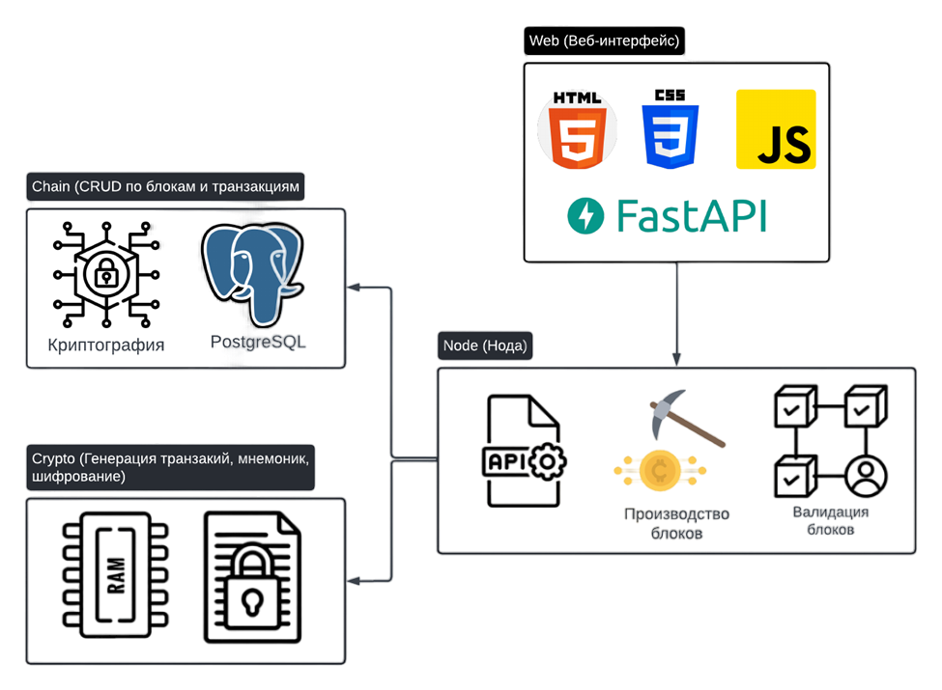
Взять лучшее из имеющегося
Для решения вышеописанных проблем идеально подходит разработанный в 2017 алгоритм Proof of Authority (PoA). Он быстрый, эффективный, менее затратный.
Адаптировать под задачу
Создать блокчейн экосистему поверх PoA. В ней должно быть все необходимое для проведения транзакций: криптография, хранилище, ноды, веб-интерфейс.

Slide 7
Поставленные задачи

Slide 8
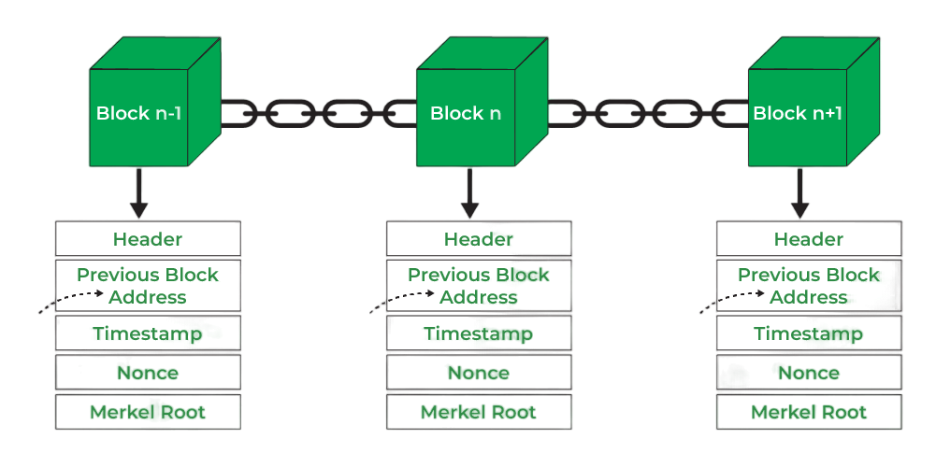
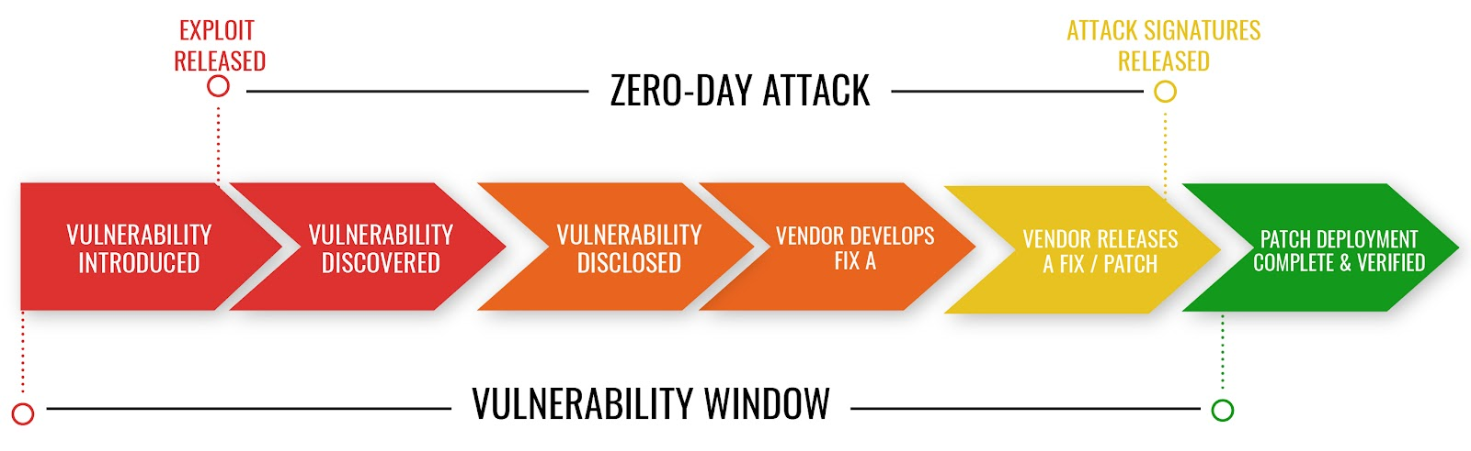

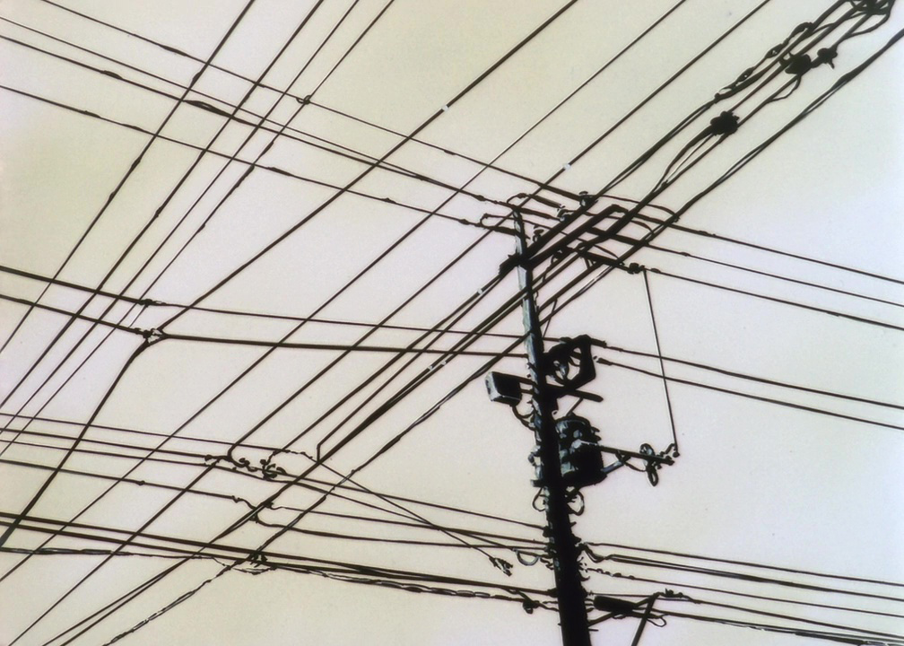
Задачи
Для создания системы проведения транзакций с помощью блокчейна на консенсус-механизме PoA требовались следующие шаги.
👉 Анализ существующих решений
👉 Выбор среды разработки
👉 Анализ потенциальных уязвимостей
👉 Разработка архитектуры взаимодействия
👉 Создание трёх основных модулей
👉 Планирование дальнейшего развития
На этапах архитектуры и анализа были выявлены некоторые проблемы
💡 Чтобы решить их нужен еще один анализ…

Slide 9
Выявленные проблемы

Slide 10
Проблемы
Goal 1
Goal 2
Goal 3
Тут описываю проблемы на след слайде описываю их решения
Outline the problem in a short paragraph or bullet points. Highlight the problem that you will solve within the case study. keep it short and snappy.
Outline the problem in a short paragraph or bullet points. Highlight the problem that you will solve within the case study. keep it short and snappy.
Goal 1
Goal 2
Goal 3
Outline the problem in a short paragraph or bullet points. Highlight the problem that you will solve within the case study. keep it short and snappy.
Outline the problem in a short paragraph or bullet points. Highlight the problem that you will solve within the case study. keep it short and snappy.
Outline the problem in a short paragraph or bullet points. Highlight the problem that you will solve within the case study. keep it short and snappy.

Slide 11

Business impact
Write a short explanation or bullet points on how your solution will impact the business.
Consider about business outcomes, and how you will messure success.
Pop an image here

Slide 12
Research

Slide 13
A bold statment that outlines your reseach conclusion. Write a single bullet point that gives high-level detail.

Slide 14
Design & Testing

Slide 15




Optional

Slide 16





Optional

Slide 17
Optional
Prototype
Prototypes

Slide 18
Optional
What is a prototype?
An example of a prototype is the first model of a new robot. Allowing stakeholders to ‘click’ or ‘tap’ though pages that have been designed like you would use a website or app.

Slide 19


Thank you,
questions?
Pop an image here
(Optional)
Presented by [Paste your name]
Product designer at [Paste Company name]

Slide 20
Optional
Technical limitations

Slide 21
Technical limitations
Optional
This is the perfect opportunity to explain the technical limitations you may have faced during this product. Not everything is simple, and sometimes we have to take technical limitations into consideration throughout the process.
Pop an image here
(Optional)
Technical limitations are usually missed out of case studies, but we know the world isn't perfect and we will hit limitations throughout a project. Highlight these and explain your compromises and what that could mean by compromising.
Example:
I faced a few technical limitations throughout the project. A full UI redesign was unable to make it into delivery. As a compromise to this business decision, I made slight adjustments to the current UI but made most of the usability improvements throughout the UX process.

Slide 22
Role and responsibility
Outline your role, company, link to website or app, and the year you worked on this project.
Example:
Pop an image here
Role: Product Designer
Company: British Airways
Website: Appstore
Year: 2022

Slide 23
Optional
Next Steps

Slide 24
Define next steps for client (optional)
Optional
Pop an image here (Optional)
If you’re presenting this back to a client, define the next steps.
👉 How would you like feedback on designs 👉 How can they contact you? 👉 Explicitly explain how you would like feedback and turn around times for feedback.
👉 Would you like a meeting to discuss further ect?

Slide 25
Proving the solution

Slide 26
Proving the solution
Proving the solutions is the most important part of the case study. This PROVES you were able to do your job and get results. Measuring success in the form of numbers are important as numbers is a language everyone speaks.
Example:
After the rounds of usability testing, I was confident that the proposed solutions were going to improve the user experience for our users.
After doing 'X' we saw:
42% decrease in...
32% increase in...
15% increase in...
20% decrease...
Pop an image here (Optional)

Slide 27
Approach

Slide 28
Approach
Write a short explanation or bullet points on how your solution will impact the business.
Consider about business outcomes, and how you will measure success.
Pop an image here
(Optional)

Slide 29
Measure success
Consider about business outcomes, and how you will measure success.
Write a short explanation or bullet points on how your solution will impact the business.
Consider about business outcomes, and how you will measure success.
Write a short explanation or bullet points on how your solution will impact the business.
Consider about business outcomes, and how you will measure success.
Write a short explanation or bullet points on how your solution will impact the business.
Consider about business outcomes, and how you will measure success.

Slide 30
Testing results
Outline the key finding from the usability testing session, validate the solution within numbers.
All participants were able to complete all tasks with ease.
But there are some areas of the journey that require enhancements.
Participants responded well to the aesthetics of the customer journey and...
- 90% of participants also found...
- 60% of participants...
- 70% of participants...
A series of usability sessions took place on UserZoom.
10 participants in total completed a round of 5 tasks.

Slide 31
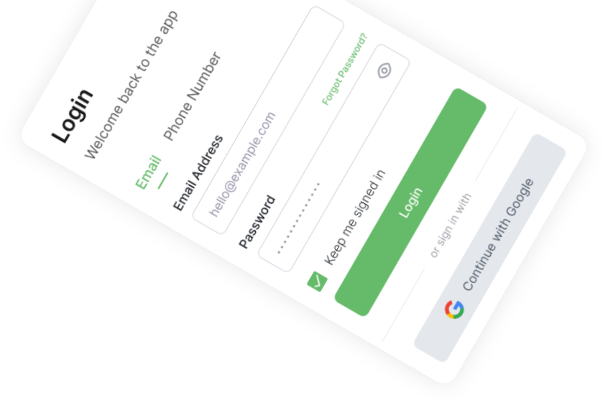
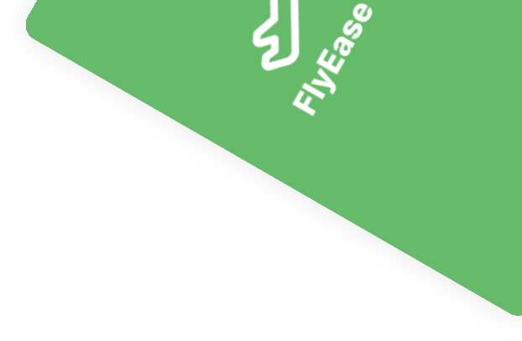
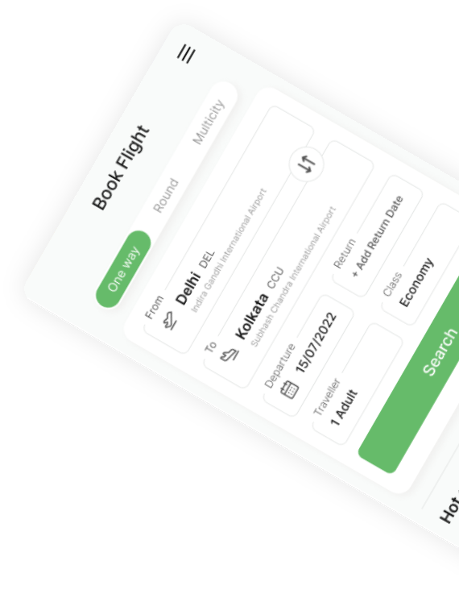
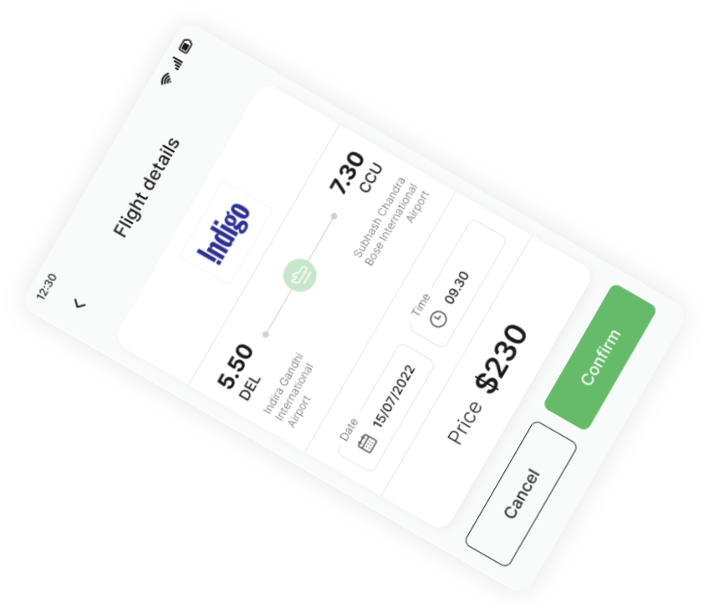

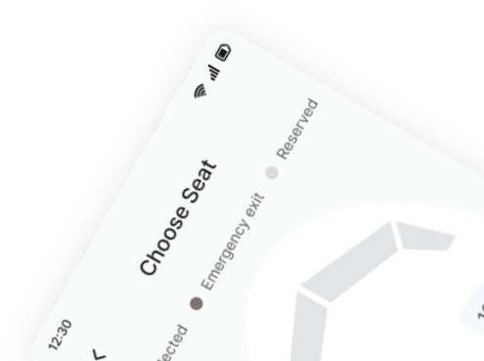
FlyEase
Case Study 2024
Presented by Gemma Helyer
Product designer at HelyerStudio

Slide 32
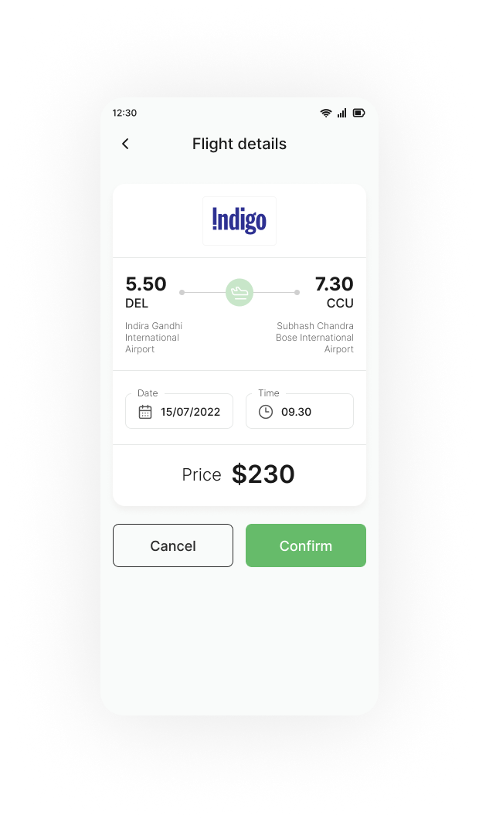
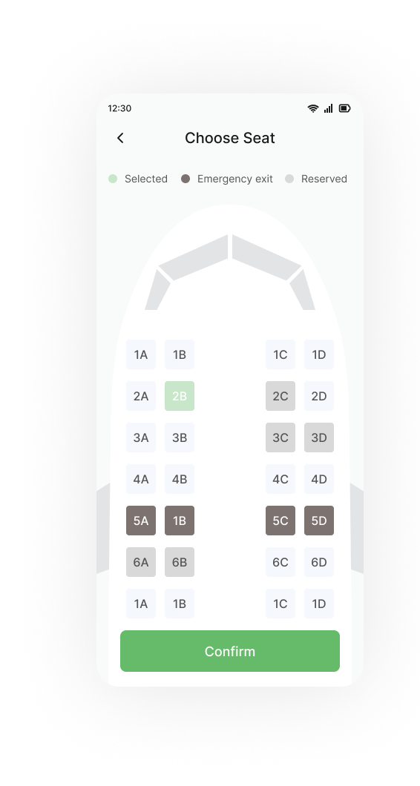
Project Summary
In this UX case study, we will explore the process of enhancing the user experience for a flight booking app, named "FlyEase."
The goal is to create a seamless and user-friendly interface that simplifies the flight booking process, making it efficient and enjoyable for users.

Slide 33
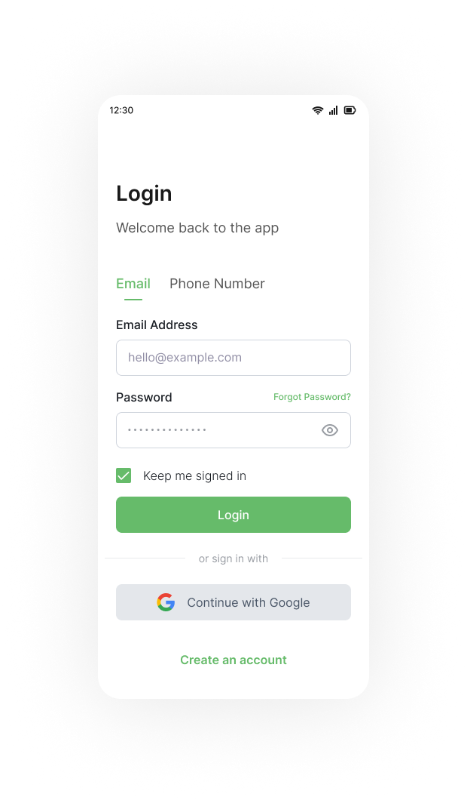
Table of contents
Project Summary
Role and responsibility
Research
Key Findings:
Design & .Testing
Proving the solution

Slide 34
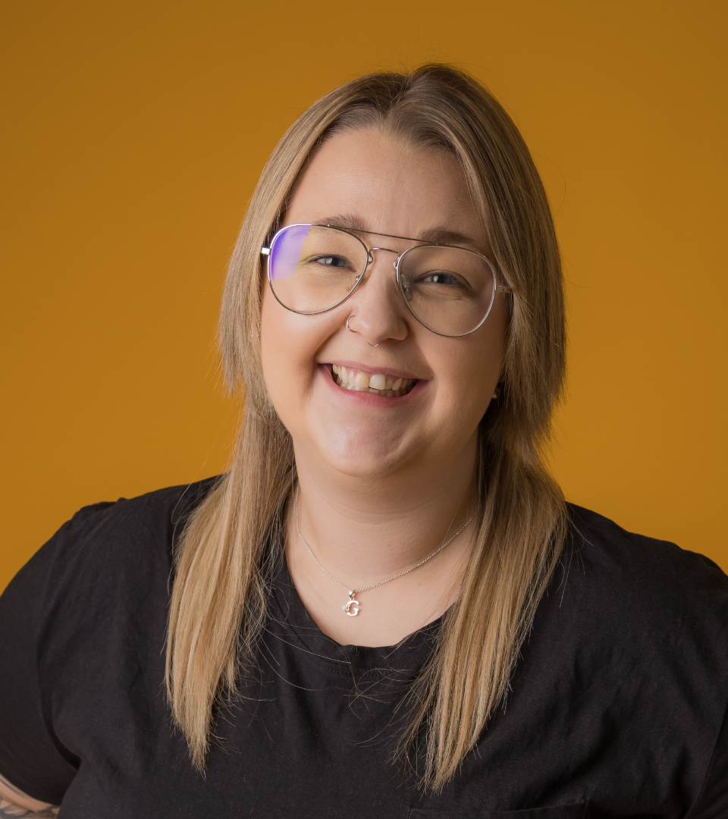
Role and responsibility
Role: Product Designer
Company: FlyEase
Website: Appstore
Year: 2024

Slide 35

Research

Slide 36
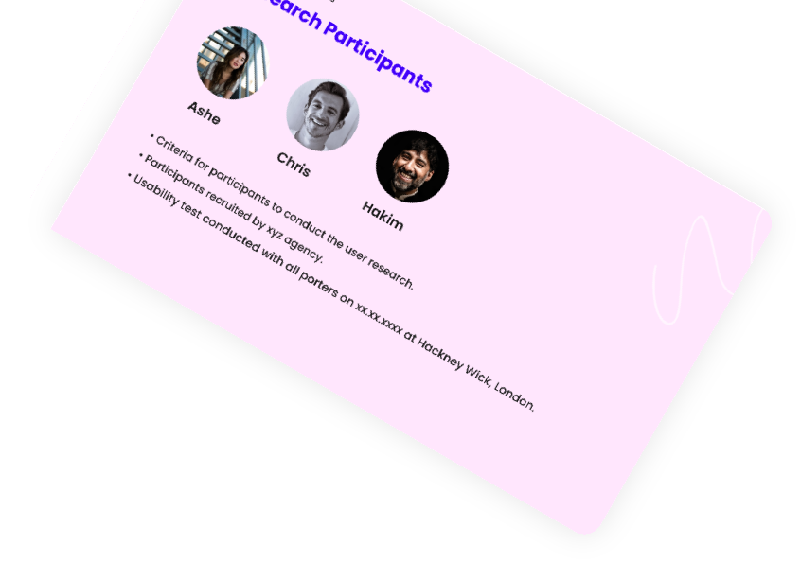
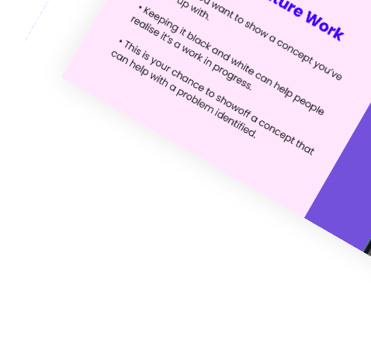
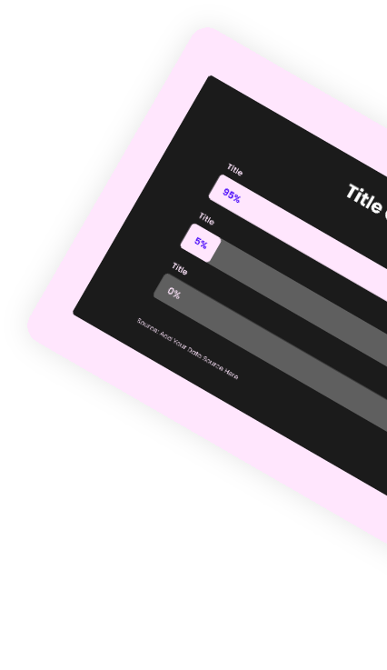
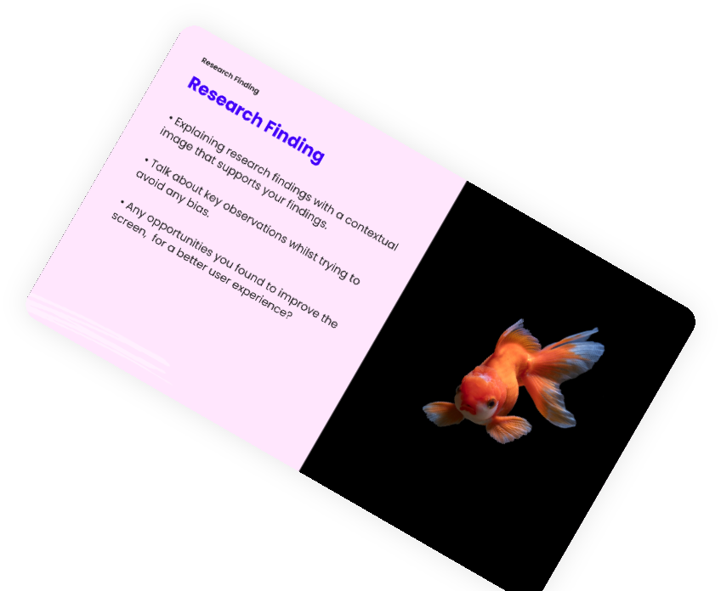
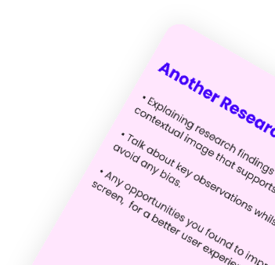
Research
FlyEase is a popular flight booking app used by frequent travelers.
While the app has been successful, user feedback and analytics indicate areas for improvement in terms of usability, efficiency, and overall satisfaction.
Research Phase:
👉 Interviews
👉Competitor Analysis
👉 Usability testing
User Research Report Template

Slide 37
Redesign the app's navigation for an intuitive structure, grouping features like flight search, filters, and booking details in a clear menu system.
Simplify the booking process with a step-by-step flow, incorporating progress indicators to guide users seamlessly through each stage.
Implemente a transparent pricing model, breaking down flight costs and highlighting additional fees. Introduced a summary page pre-payment for a comprehensive overview of expenses.

Slide 38
Key Findings
Complex Navigation: Users found it challenging to navigate through the app, especially when searching for specific flights or modifying their travel details.
Information Overload:
The abundance of information during the booking process overwhelmed users. They struggled to filter and prioritize details like flight times, prices, and amenities.
Transparency Issues:
Users expressed concerns about hidden fees and ambiguous pricing structures. This lack of transparency eroded trust and affected the overall user experience
Conducted usability testing sessions with current users of FlyEase.
Observed users interacting with the app, noting areas where they struggled, encountered confusion, or expressed frustration.

Slide 39
Proving the solution

Slide 40
Design & Testing

Slide 41
Design
In this UX case study, we will explore the process of enhancing the user experience for a flight booking app, named "FlyEase."
The goal is to create a seamless and user-friendly interface that simplifies the flight booking process, making it efficient and enjoyable for users.

Slide 42
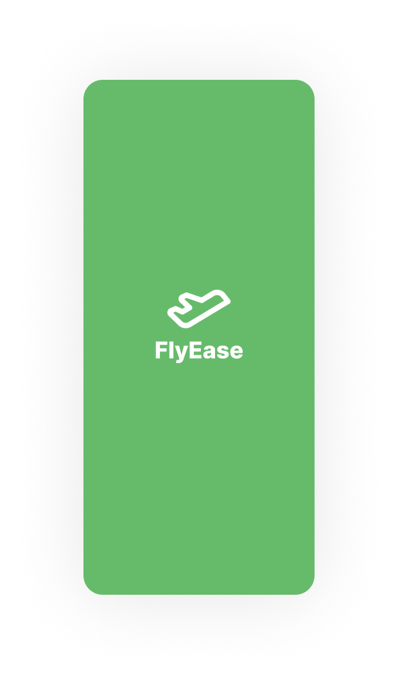
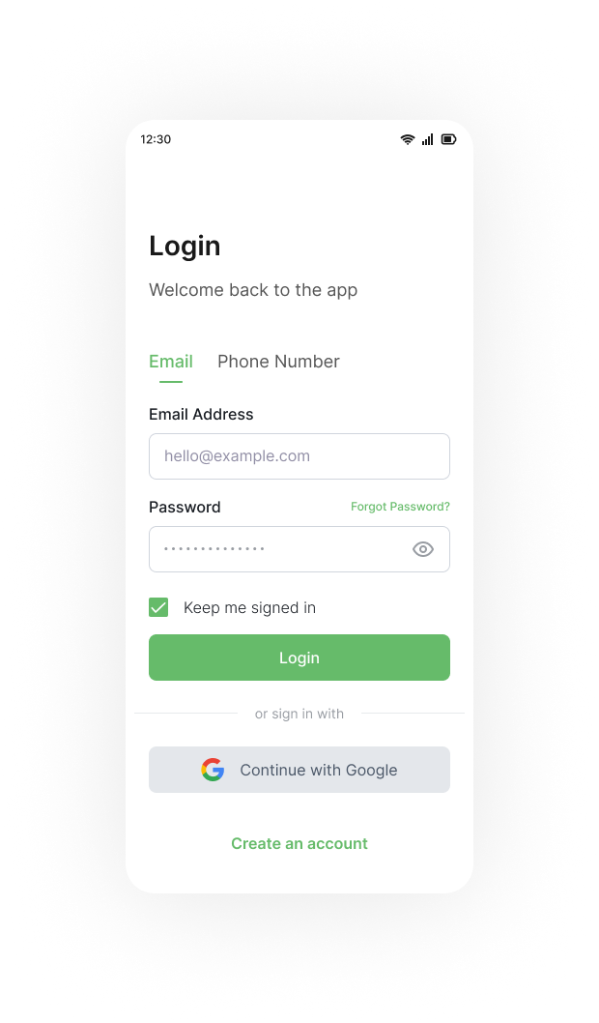
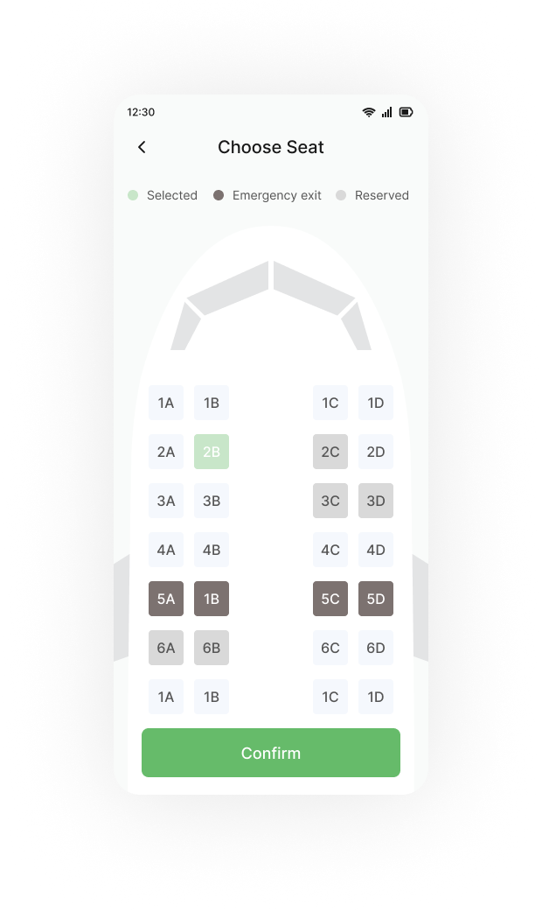

Slide 43
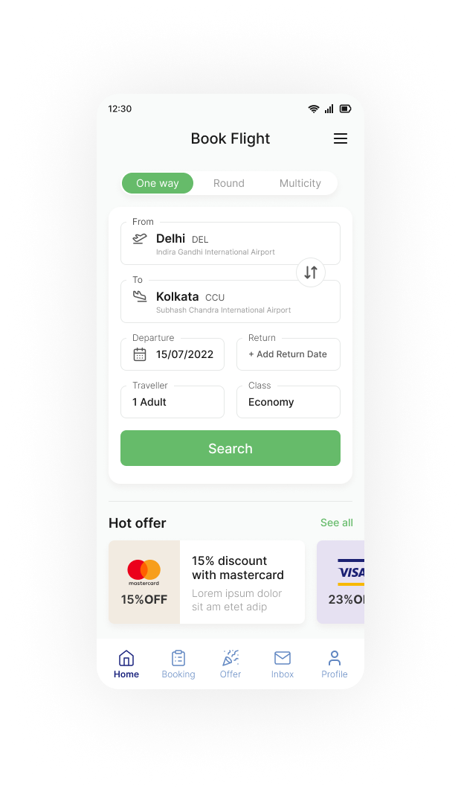
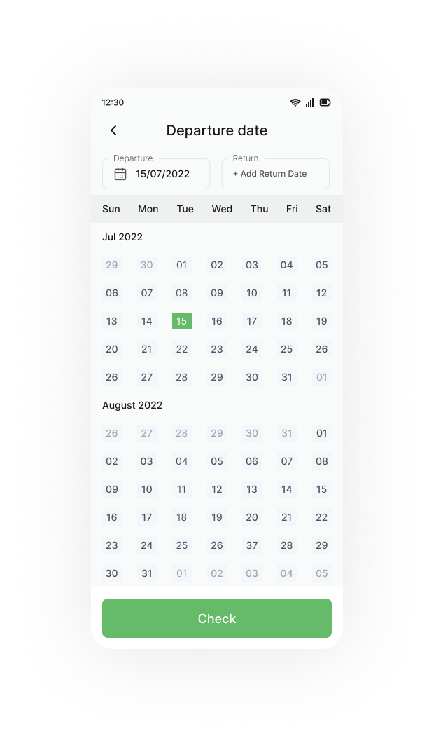
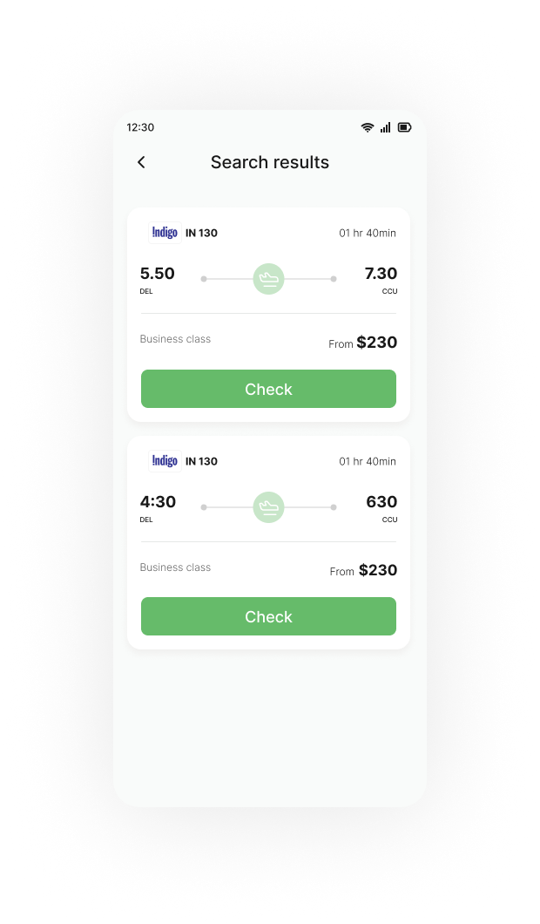


Slide 44

Usability testing
Created interactive prototypes to simulate the new navigation and booking flow. Gathered feedback from users and stakeholders to refine the design further.
Conducted additional usability testing with the updated prototypes. Observed positive reactions to the simplified navigation and improved transparency. Made minor adjustments based on user feedback.
User Research Report Template

Slide 45
Key Findings
Improved User Satisfaction:
User feedback and app store reviews indicated increased satisfaction with the simplified navigation and streamlined booking process.
Increased Conversions:
The updated app witnessed a boost in conversion rates, as users found it easier to complete bookings without unnecessary complications.
Enhanced Trust:
The transparent pricing model and clear communication helped rebuild user trust, leading to improved brand perception.

Slide 46
By focusing on user research, design iteration, and transparent communication, the FlyEase flight booking app successfully transformed its user experience.
The result was a more intuitive, efficient, and enjoyable platform that met the needs and expectations of its users, contributing to increased user satisfaction and business success.page pre-payment for a comprehensive overview of expenses.

Slide 47
Thank you, questions?
Presented by Gemma Helyer
Product designer at HelyerStudio

